Slide 1

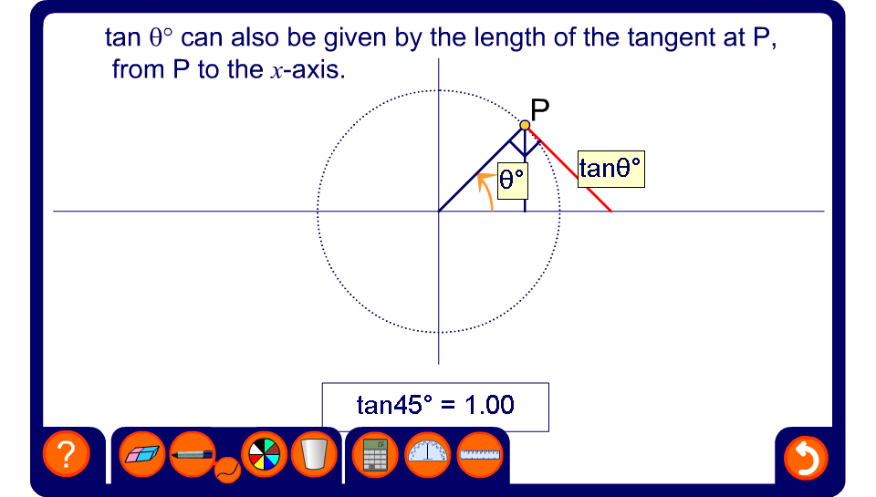


The tangent of any angle
Notes:
This demonstration shows more clearly how the value of tan θ varies as θ varies. In particular, it can be shown that tan 90° and tan 270° are undefined. This is because the tangent is parallel to the x-axis at these points.
Explain to pupils that the length of the tangent at P from P to the x-axis gives us the value of tan θ. Remind pupils that the tangent of a circle forms a right angle with the radius. We therefore have a right-angled triangle with opposite side of length tan θ and adjacent side of length 1. Opposite/adjacent = tan θ as required.
Slowly move the point P through 0° < θ < 360° and observe how the value of tan θ varies. Draw pupils attention to the fact that when θ is close to 90° and 270° it get very large very quickly. Establish that at these points the tangent at P is parallel to the x-axis. Since the tangent will never meet the x-axis at 90° or 270° tan θ is undefined at these angles.
The slope of the tangent defines whether it is positive or negative. A positive gradient gives a negative value and a negative gradient gives a positive value.

